Slide 1
First Idea talk: Forecasting agile project success using SAP Data warehouse cloud
Mark Fromm
Business information systems

Slide 2
Motivation / Problem statement
Companies implement their strategies through projects
Project success rates are very low
Bad economic impact
Need for alternative tools to estimate project success

Slide 3
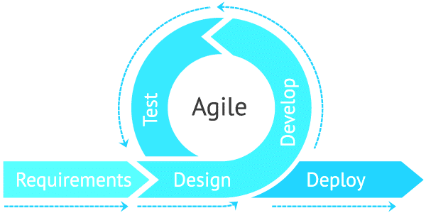
What is agile project management?
Agile project management is an iterative approach to delivering a project throughout its life cycle
frequently used in software development projects to promote velocity and adaptability
Aim: release benefits throughout the process rather than only at the end

Slide 4
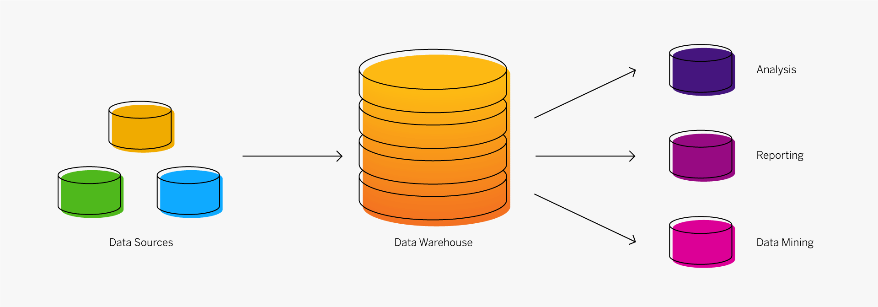
What is sap data warehouse cloud?
cloud-based Data Warehouse
system used for reporting and data analysis
central repositories of integrated data from one or more disparate sources
store current and historical data in one single place
offers possibilities to map, transform, model and visualize data

Slide 5

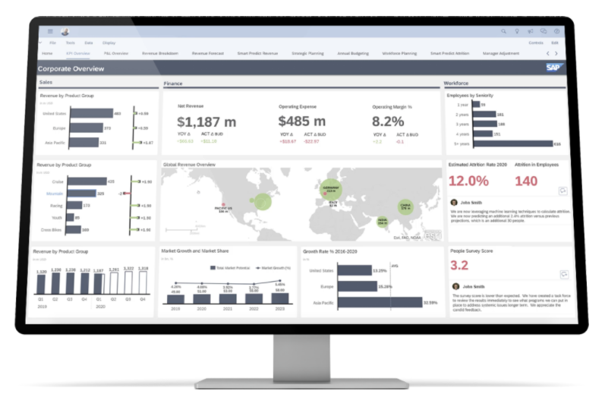





Current Architecture
Visualizing the outcome using SAP Analytics Cloud
SAC
Data is being loaded and transformed inside the SAP Data Warehouse Cloud
DWC
Data is being extracted with a Python ETL script using Jira-API
ETL
Source System
Project Data from Jira

Slide 6






Target Architecture
Project Data
Prediction
Additional Data Sources

Slide 7
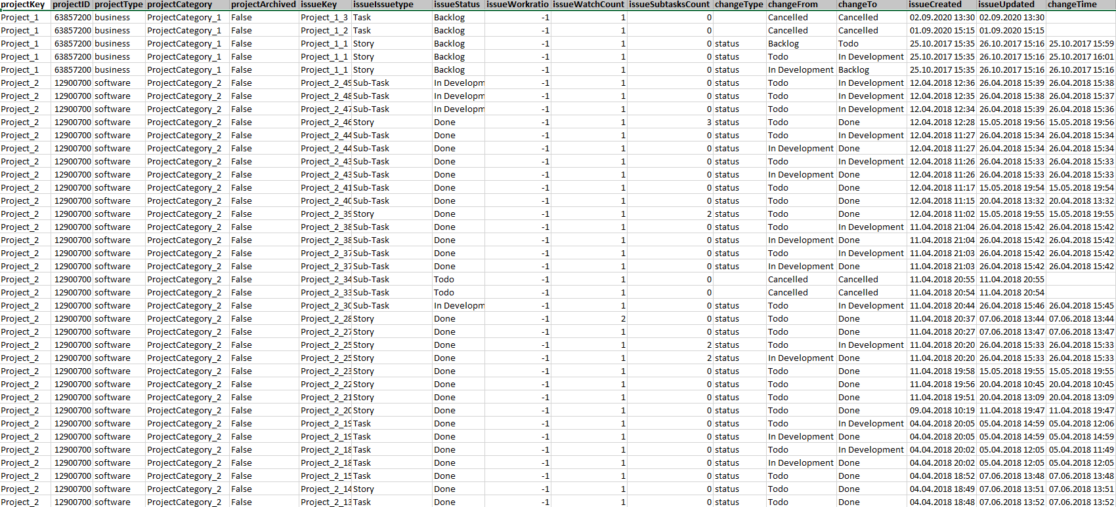
Dataset exploration
8871 rows
Nominal Data (e.g. Project Type)
Numerical Data (e.g. Work ratio)
Timeseries Data

Slide 8
Target Class: ´project_success‘
is not defined in the dataset
must be created based on available figures or expert knowledge
literature review to explore key figures and define project success for the given project data
Problem: Projects take place in a complex and uncertain environment
Aim: create a categorical, ordinal-scaled measure for project success

Slide 9
agenda
1) Questionnaire / Research to define Target Class in Dataset
2) Collect additional Data and combine it within the Data Warehouse
3) Apply Machine Learning Classification Algorithms (e.g. logistic regression, logistic regression, ARIMA) to receive a model to forecast future project success

Slide 10
Research questions
How can we predict project success using JIRA data on DWC?
What type of data do we need to define project success?
How can we combine this data?
Which Machine Learning Algorithms suits for this type of problem?
How can we use the SAP DWC and ist features to build an Analytics environment?

Slide 11
sources
https://www.apm.org.uk/resources/find-a-resource/agile-project-management/
https://hive.com/blog/what-is-agile-project-management-methodology/
https://insights.sap.com/what-is-a-data-warehouse/
https://blog.rjmetrics.com/2014/12/04/10-common-mistakes-when-building-a-data-warehouse
Dedić, Nedim; Stanier, Clare (2016)

